Slide 1
Parks, Racetracks, and Gardens
Ariel Griffeth

Slide 2
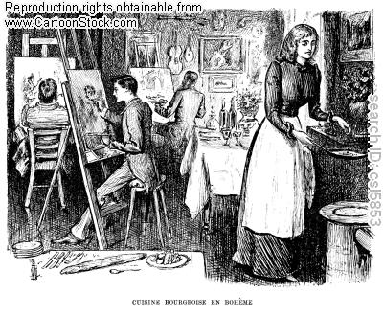
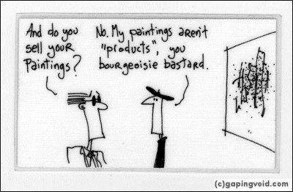
The Bourgeoisie
Notes:
True middle class as completely separate from lower and middle classes

Slide 3
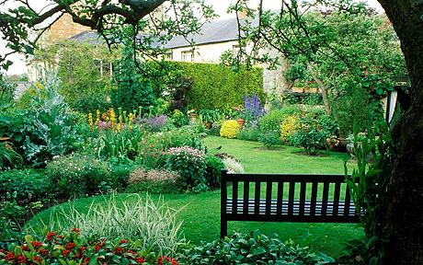
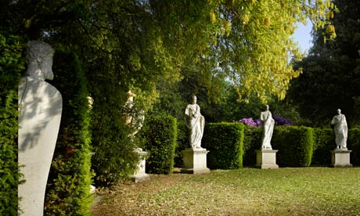
Britain
Notes:
Louis Napoleon’s value of British natural aesthetic (British taste and hegemonic industry “not nature, but ‘nature,’ a reconstruction of the physical world derived from the British tradition of the natural garden” (149); rapid growth of parks (47 acres to 4,500 acres) planting of over 400,000 trees

Slide 4
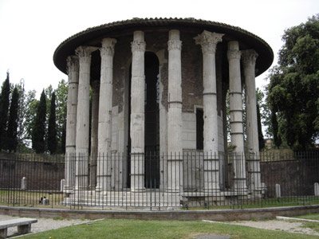
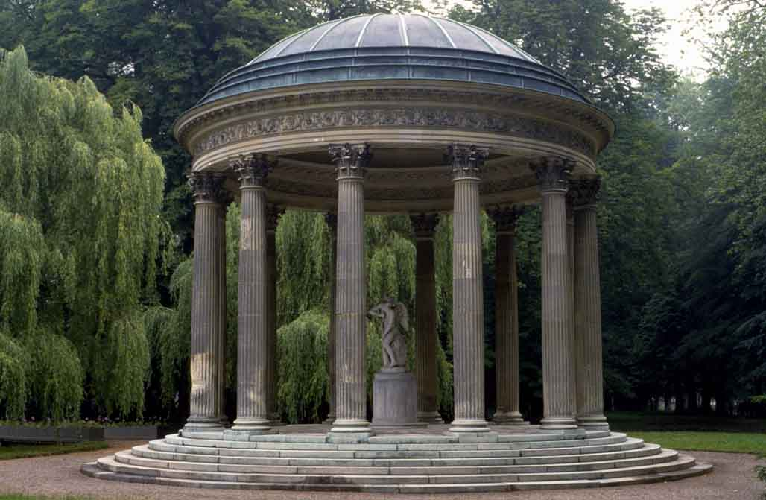
Greece/Italy
Notes:
Adolphe Alphand in charge of park reconstruction – conversion of old quarries; Buttes Chaumont had “been the site of public executions and of waste disposal” (grottoes including man-made stalagmites and stalagmites, artificial lake, streams, Temple of Vesta in landscape; restaurants, cafes, chalets, greenswards to contribute to community and social activities); new streets reduce the size of some previously established parks and are an attempt to attribute “the idea of Paris as the premier nexus of international culture” (142); immense geometrical influence, attempt at “perspective” with lawns, ponds, streams, and woods (145)

Slide 5
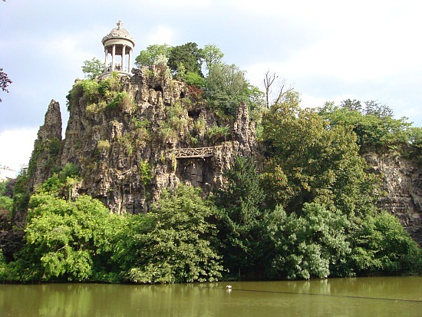
Product of Inspiration
Notes:
Impressionism as an inspiration for other media (literature and music) Debussy VIDEO, mention jazz, syncopations

Slide 6
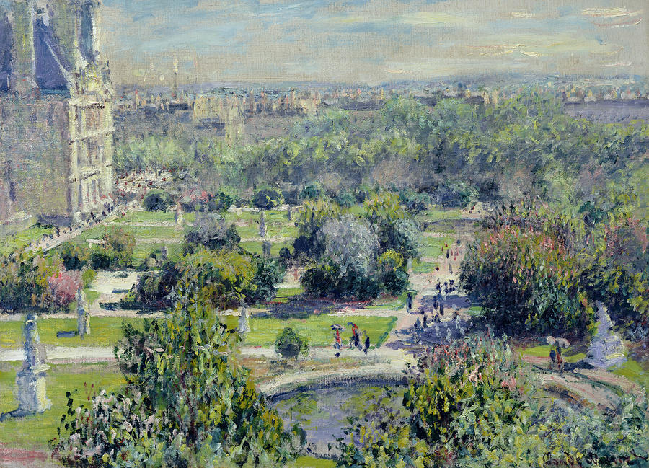
Paris
Monet. The Tuileries. 1876.
Notes:
Adolphe Alphand in charge of park reconstruction – conversion of old quarries; Buttes Chaumont had “been the site of public executions and of waste disposal” (grottoes including man-made stalagmites and stalagmites, artificial lake, streams, Temple of Vesta in landscape; restaurants, cafes, chalets, greenswards to contribute to community and social activities); new streets reduce the size of some previously established parks and are an attempt to attribute “the idea of Paris as the premier nexus of international culture” (142); immense geometrical influence, attempt at “perspective” with lawns, ponds, streams, and woods (145)

Slide 7
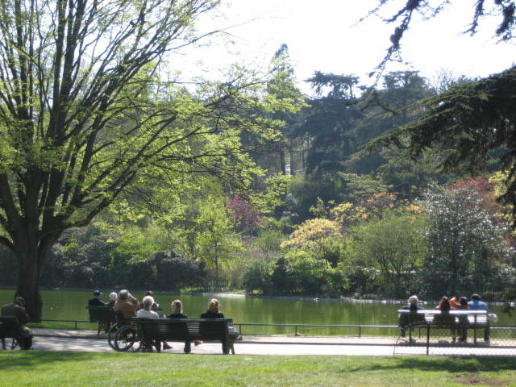
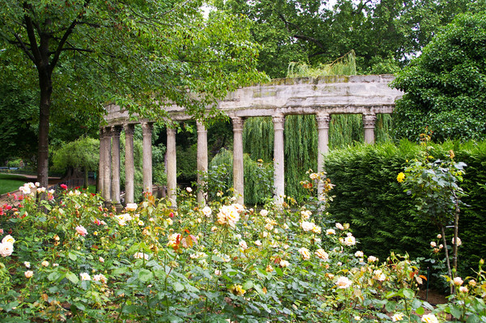
Paris
Notes:
Adolphe Alphand in charge of park reconstruction – conversion of old quarries; Buttes Chaumont had “been the site of public executions and of waste disposal” (grottoes including man-made stalagmites and stalagmites, artificial lake, streams, Temple of Vesta in landscape; restaurants, cafes, chalets, greenswards to contribute to community and social activities); new streets reduce the size of some previously established parks and are an attempt to attribute “the idea of Paris as the premier nexus of international culture” (142); immense geometrical influence, attempt at “perspective” with lawns, ponds, streams, and woods (145)

Slide 8
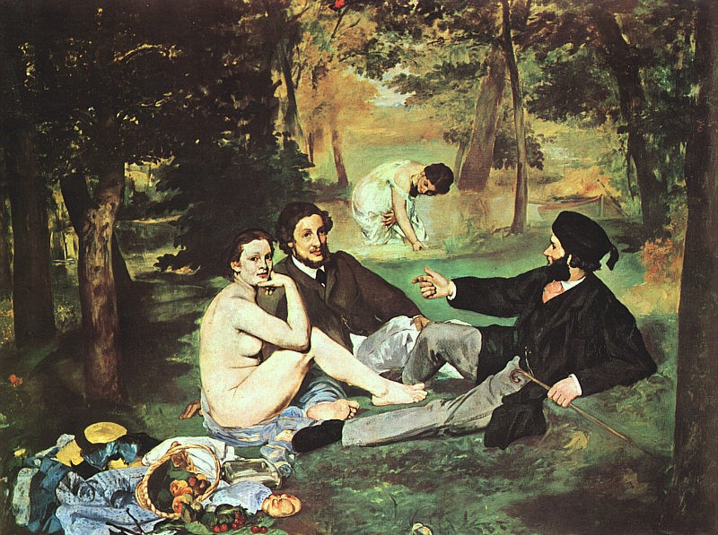
Luncheon on the Grass
Manet. The Luncheon on the Grass. 1863.
Notes:
Picnics, repetitive imagery, continuously being drawn back to tradition i.e. mythological or classically based works – hedonism, Rococo comparison

Slide 9
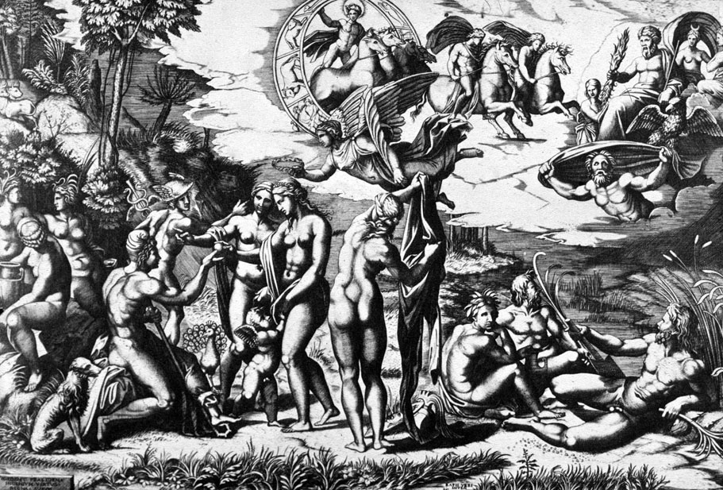
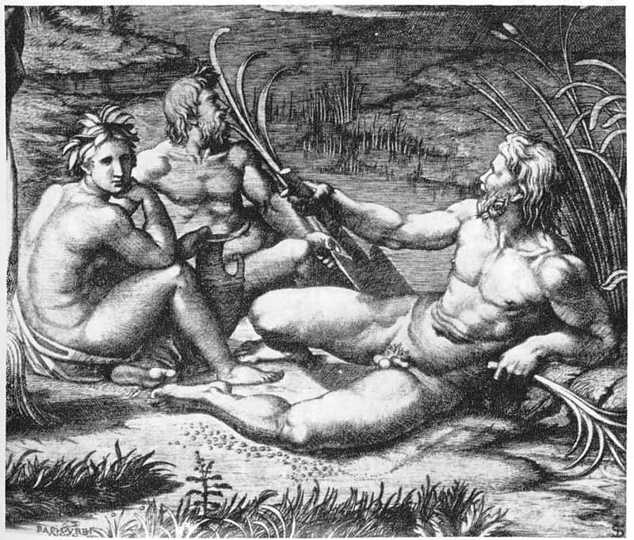
Influences
Raimondi. The Judgment of Paris. 1525-30.
Notes:
Picnics, repetitive imagery, continuously being drawn back to tradition i.e. mythological or classically based works – hedonism, Rococo comparison

Slide 10
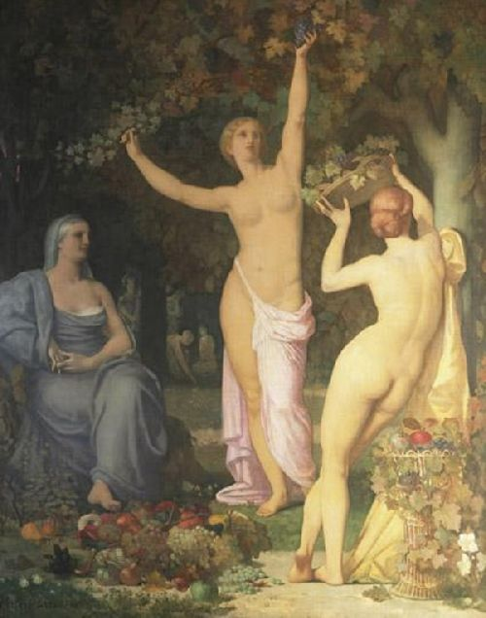
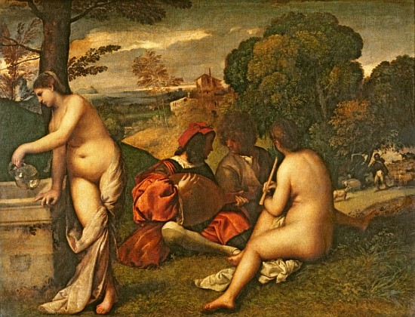
Influences
Puvis de Chavannes. Autumn. 1864.
Titian. The Concert. 1508.
Notes:
Picnics, repetitive imagery, continuously being drawn back to tradition i.e. mythological or classically based works – hedonism, Rococo comparison

Slide 11
Luncheon on the Grass
Manet. The Luncheon on the Grass. 1863.
Notes:
Picnics, repetitive imagery, continuously being drawn back to tradition i.e. mythological or classically based works – hedonism, Rococo comparison

Slide 12
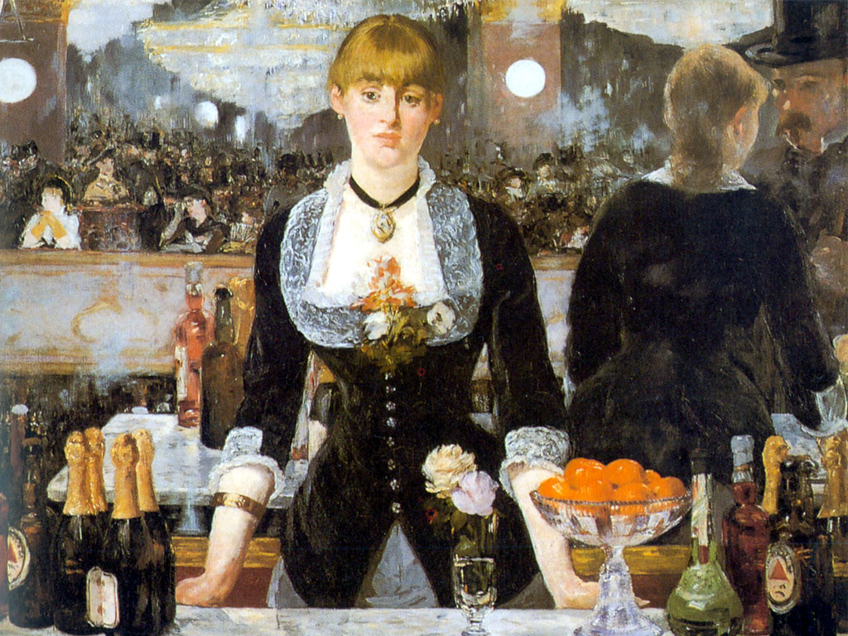
Compare to The Bar at the Folies Bergère
The Bar at the Folies Bergère. 1882.
The Luncheon on the Grass. 1863.
Notes:
Picnics, repetitive imagery, continuously being drawn back to tradition i.e. mythological or classically based works – hedonism, Rococo comparison

Slide 13
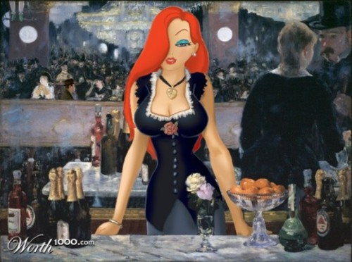
The Bar at the Folies Bergère
Notes:
Picnics, repetitive imagery, continuously being drawn back to tradition i.e. mythological or classically based works – hedonism, Rococo comparison

Slide 14
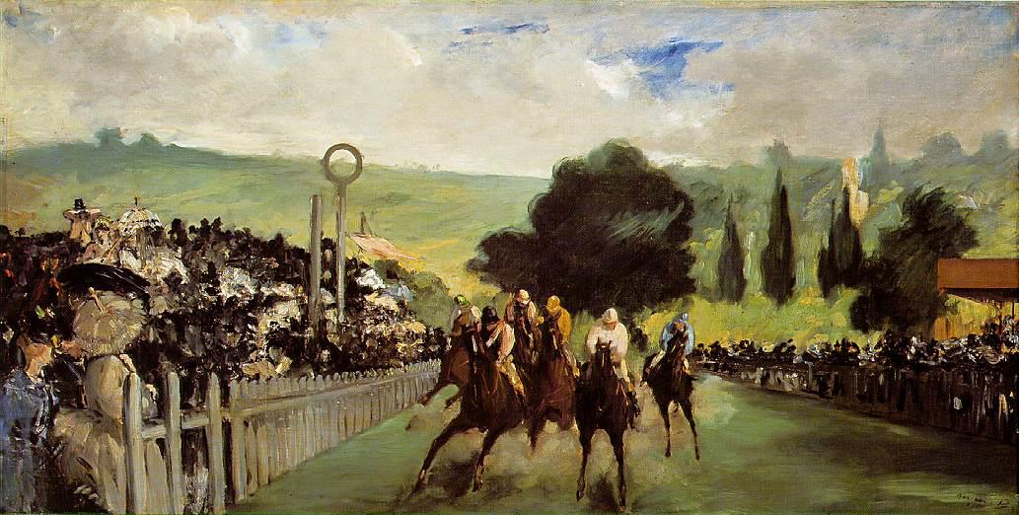
Racetracks and Dandies
Manet. The Races at Longchamp. 1864.
Notes:
Racetracks as a display of fashion (derived from British love of horses, “French Dandy at least pretended” to have an immense interest in the race (154) “onlookers have become our show” (158) – Manet and Degas

Slide 15
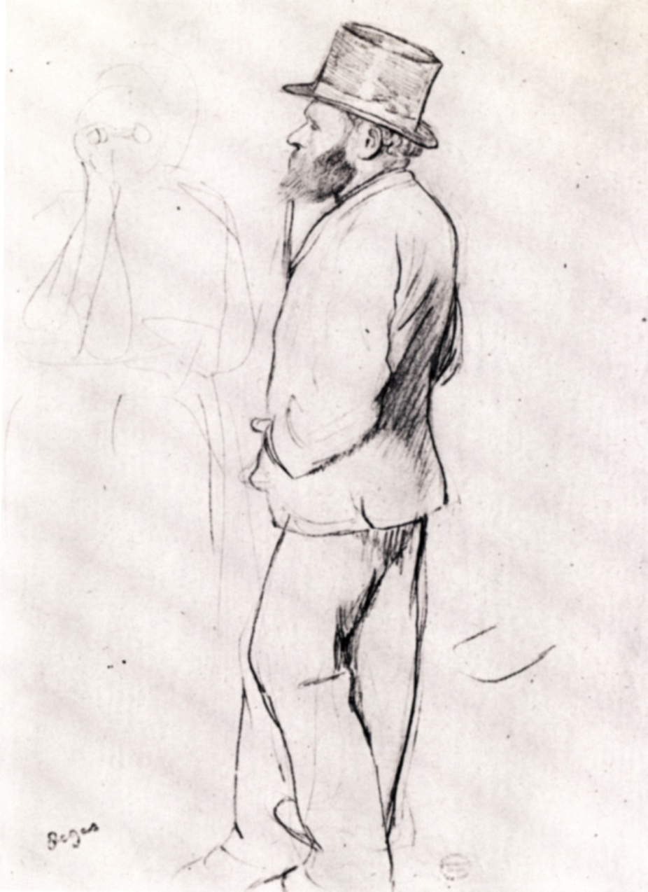
Manet and Degas
Degas.
Manet at the Races.
1870-72.
Notes:
Racetracks as a display of fashion (derived from British love of horses, “French Dandy at least pretended” to have an immense interest in the race (154) “onlookers have become our show” (158) – Manet and Degas

Slide 16
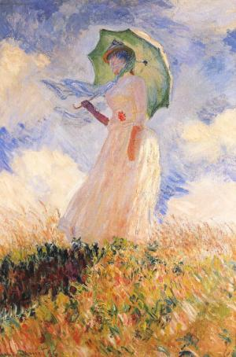
Technique and en Plein air
Monet. Woman with a Parasol. 1875.
Notes:
Monet – en plein air obsession “naturalism is not an absolute, but a relative concept,” (178) flowers and fashion (“appropriate” dress, “distance from the lower classes” (178)) – display/flaunt/advertisement of fashion VIDEO

Slide 17
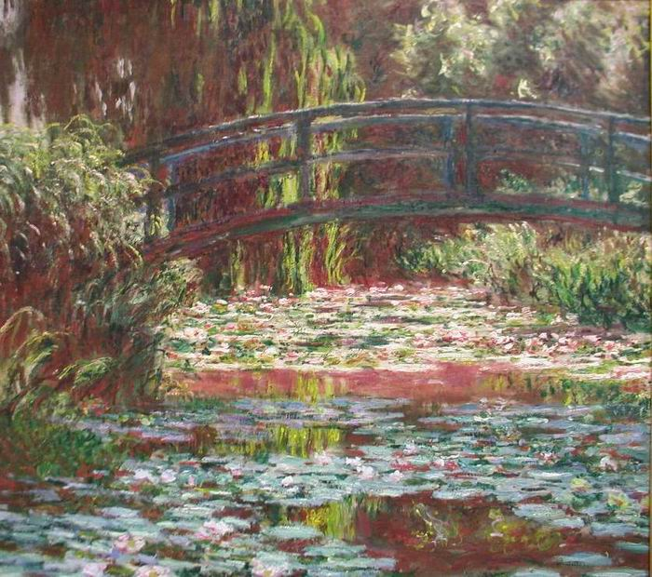
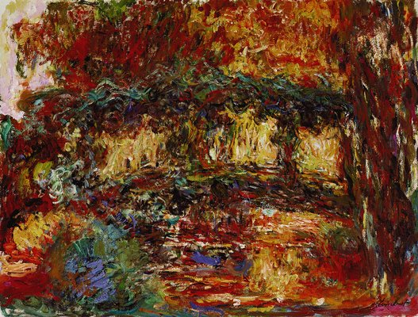
Japanese Footbridge, Giverny
Notes:
DID NOT INCLUE GIVERNY
monet was made aware of the changes in color and “fixed some paintings”
Monet Refuses the Operation
around the streetlights in Paris
and what I see is an aberration
caused by old age, an affliction.
I tell you it has taken me all my life
to arrive at the vision of gas lamps as angels,
to soften and blur and finally banish
the edges you regret I don’t see,
to learn that the line I called the horizon
does not exist and sky and water,
so long apart, are the same state of being.
Fifty-four years before I could see
Rouen cathedral is built
of parallel shafts of sun,
and now you want to restore
my youthful errors: fixed
notions of top and bottom,
the illusion of three-dimensional space,
wisteria separate
from the bridge it covers.
What can I say to convince you
the Houses of Parliament dissolve
night after night to become
the fluid dream of the Thames?
I will not return to a universe
of objects that don’t know each other,
as if islands were not the lost children
of one great continent. The world
is flux, and light becomes what it touches,
becomes water, lilies on water,
above and below water,
becomes lilac and mauve and yellow
and white and cerulean lamps,
small fists passing sunlight
so quickly to one another
that it would take long, streaming hair
inside my brush to catch it.
To paint the speed of light!
Our weighted shapes, these verticals,
burn to mix with air
and change our bones, skin, clothes
to gases. Doctor,
if only you could see
how heaven pulls earth into its arms
and how infinitely the heart expands
to claim this world, blue vapor without end.
around the streetlights in Paris
and what I see is an aberration
caused by old age, an affliction.
I tell you it has taken me all my life
to arrive at the vision of gas lamps as angels,
to soften and blur and finally banish
the edges you regret I don’t see,
to learn that the line I called the horizon
does not exist and sky and water,
so long apart, are the same state of being.
Fifty-four years before I could see
Rouen cathedral is built
of parallel shafts of sun,
and now you want to restore
my youthful errors: fixed
notions of top and bottom,
the illusion of three-dimensional space,
wisteria separate
from the bridge it covers.
What can I say to convince you
the Houses of Parliament dissolve
night after night to become
the fluid dream of the Thames?
I will not return to a universe
of objects that don’t know each other,
as if islands were not the lost children
of one great continent. The world
is flux, and light becomes what it touches,
becomes water, lilies on water,
above and below water,
becomes lilac and mauve and yellow
and white and cerulean lamps,
small fists passing sunlight
so quickly to one another
that it would take long, streaming hair
inside my brush to catch it.
To paint the speed of light!
Our weighted shapes, these verticals,
burn to mix with air
and change our bones, skin, clothes
to gases. Doctor,
if only you could see
how heaven pulls earth into its arms
and how infinitely the heart expands
to claim this world, blue vapor without end.

Slide 18
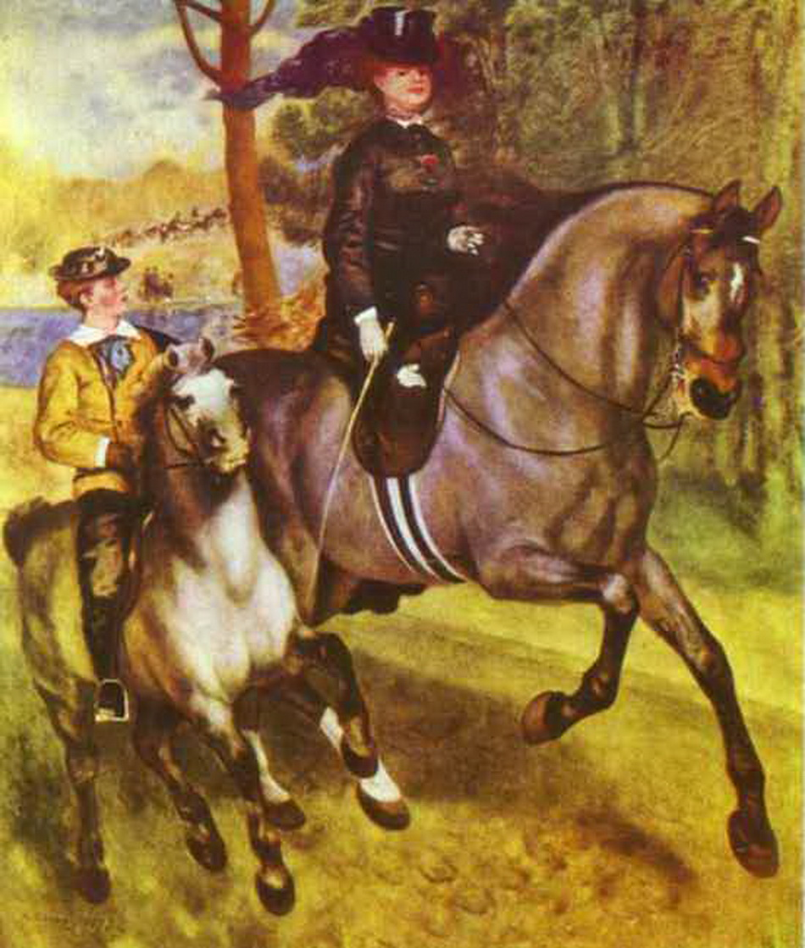
Compare
Renoir. A Morning Ride in the Bois de Boulogne. 1873.
Notes:
Comparison of Renoir’s The Morning Ride and Skaters in the Bois de Boulogne – rejection and exhibition of The Morning Ride in the Salon de Refuses; combination of the contemporary and the traditional “celebrations of contemporary life” (150)

Slide 19
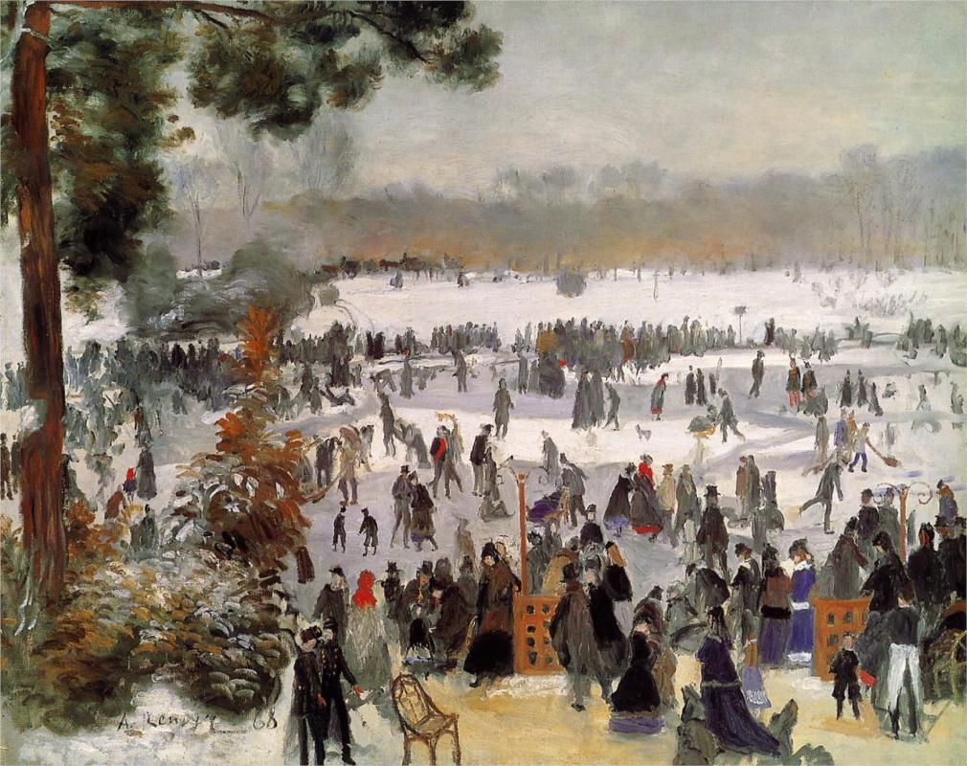
Compare
Renoir. Skaters in the Bois de Boulogne. 1868.
Notes:
Comparison of Renoir’s The Morning Ride and Skaters in the Bois de Boulogne – rejection and exhibition of The Morning Ride in the Salon de Refuses; combination of the contemporary and the traditional “celebrations of contemporary life” (150)

Slide 20
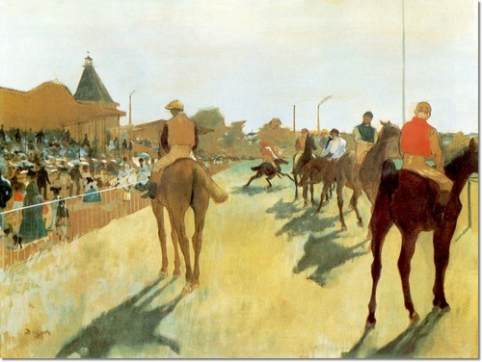
Degas vs. Monet
Degas. The Horse Races. 1869.
Notes:
Degas’s continuous disregard for faithfulness to what is actually seen vs. Monet’s immense realistic depiction with light – play of light to influence emotion, eye movement

Slide 21
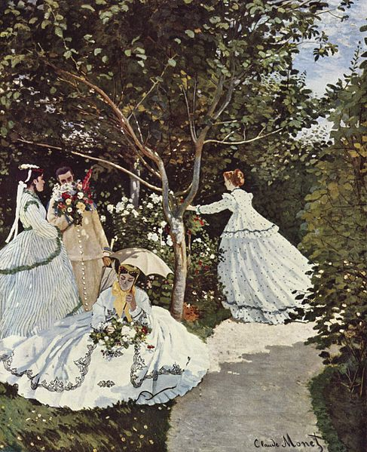
Degas vs. Monet
Monet. Women in a Garden. 1866-67.
Notes:
Degas’s continuous disregard for faithfulness to what is actually seen vs. Monet’s immense realistic depiction with light – play of light to influence emotion, eye movement

Slide 22
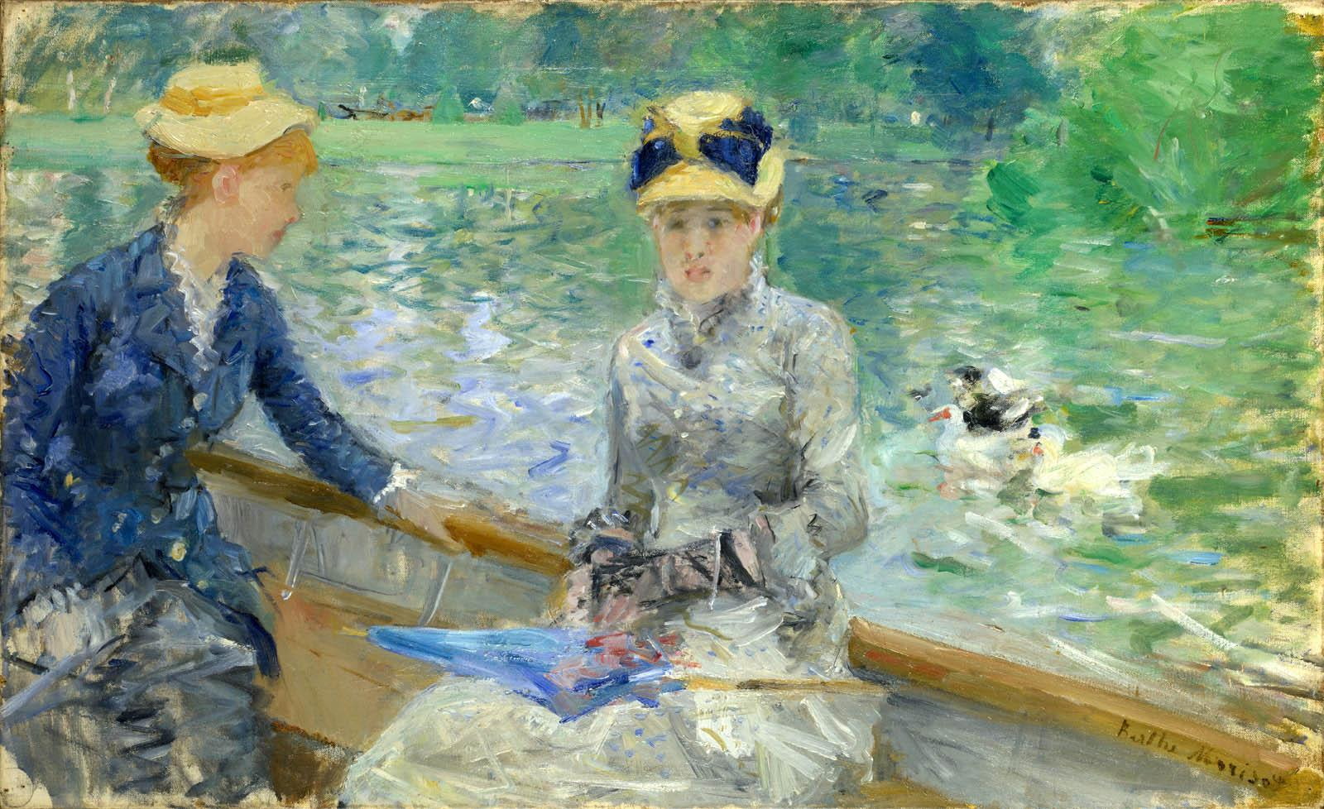
Summer’s Day
Morisot. Summer’s Day. 1879.
Notes:
Degas’s continuous disregard for faithfulness to what is actually seen vs. Monet’s immense realistic depiction with light – play of light to influence emotion, eye movement

Slide 23
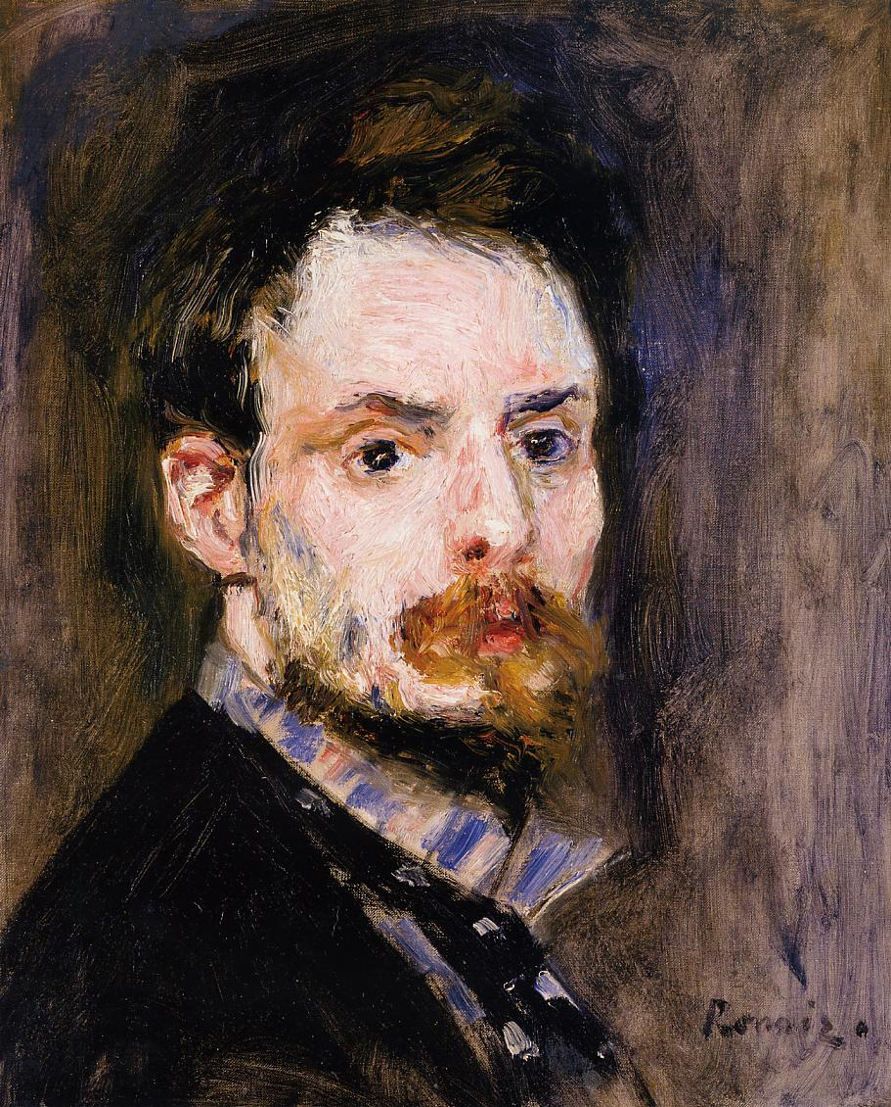
Renoir
Notes:
Renoir as a landscapist and portrait painter; misanthropic views, women and children and attempt to separate “them from work and life’s harsh realities” (188), “what does the rest of humanity matter to them!” (190), “‘false mania of perfection’ has cast God out,” “nature was the place where man could free himself from the taint of civilization” (192) – brushwork as expression of culmination of a longing for the natural world and a rejection of urban-industrialism

Slide 24
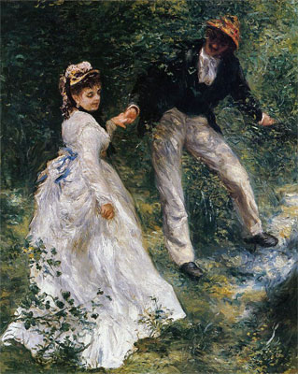
Renoir
Renoir. The Promenade. 1870.
Notes:
Renoir as a landscapist and portrait painter; misanthropic views, women and children and attempt to separate “them from work and life’s harsh realities” (188), “what does the rest of humanity matter to them!” (190), “‘false mania of perfection’ has cast God out,” “nature was the place where man could free himself from the taint of civilization” (192) – brushwork as expression of culmination of a longing for the natural world and a rejection of urban-industrialism

Slide 25
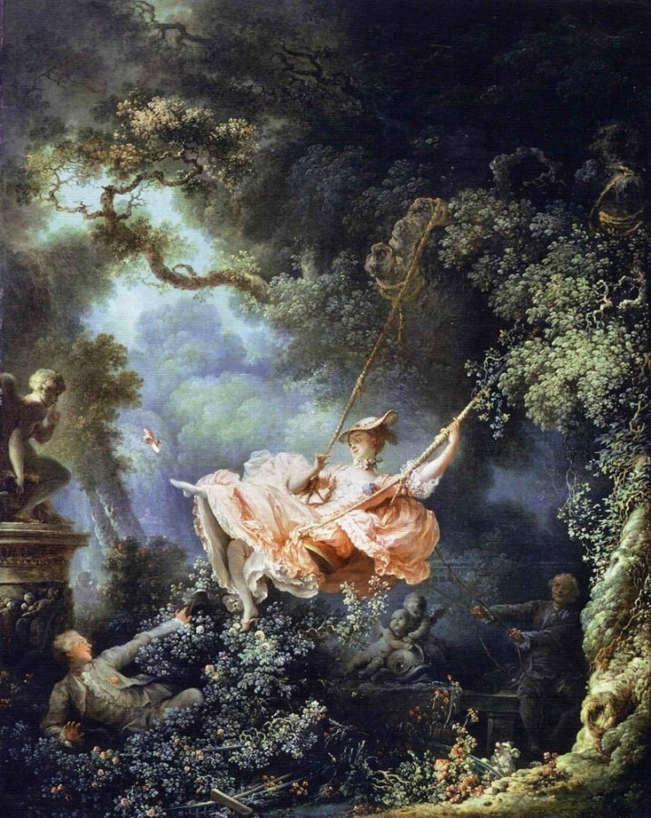
Fragonard
Fragonard. The Swing. 1767.
Notes:
Renoir as a landscapist and portrait painter; misanthropic views, women and children and attempt to separate “them from work and life’s harsh realities” (188), “what does the rest of humanity matter to them!” (190), “‘false mania of perfection’ has cast God out,” “nature was the place where man could free himself from the taint of civilization” (192) – brushwork as expression of culmination of a longing for the natural world and a rejection of urban-industrialism

Slide 26
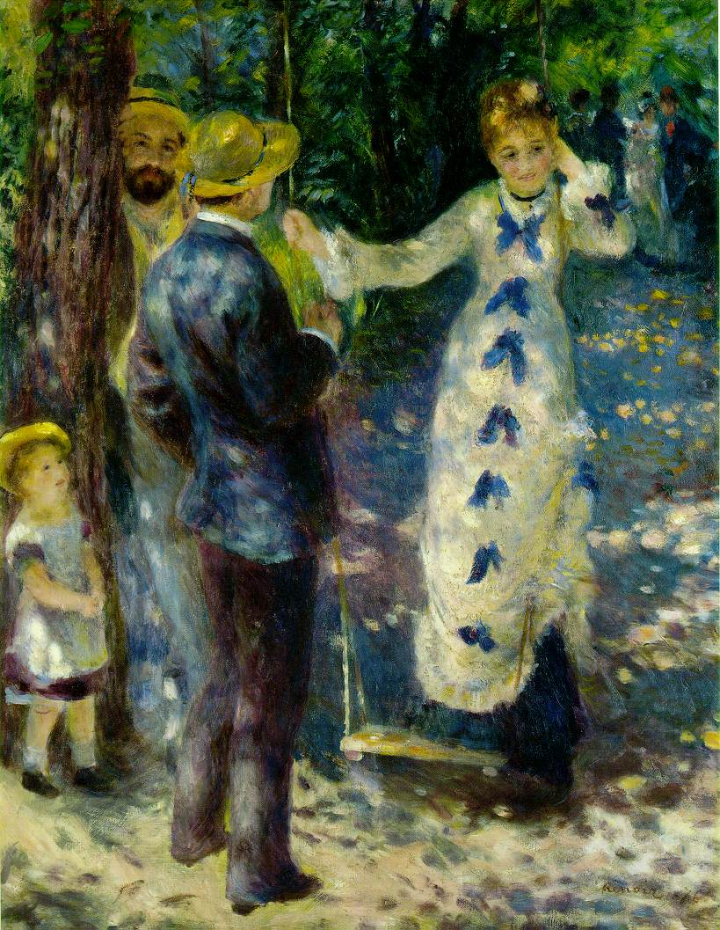
Renoir
Renoir. The Swing. 1876.
Notes:
Renoir as a landscapist and portrait painter; misanthropic views, women and children and attempt to separate “them from work and life’s harsh realities” (188), “what does the rest of humanity matter to them!” (190), “‘false mania of perfection’ has cast God out,” “nature was the place where man could free himself from the taint of civilization” (192) – brushwork as expression of culmination of a longing for the natural world and a rejection of urban-industrialism

Slide 27
Fragonard
Fragonard. The Swing. 1767.
Notes:
Renoir as a landscapist and portrait painter; misanthropic views, women and children and attempt to separate “them from work and life’s harsh realities” (188), “what does the rest of humanity matter to them!” (190), “‘false mania of perfection’ has cast God out,” “nature was the place where man could free himself from the taint of civilization” (192) – brushwork as expression of culmination of a longing for the natural world and a rejection of urban-industrialism

Slide 28
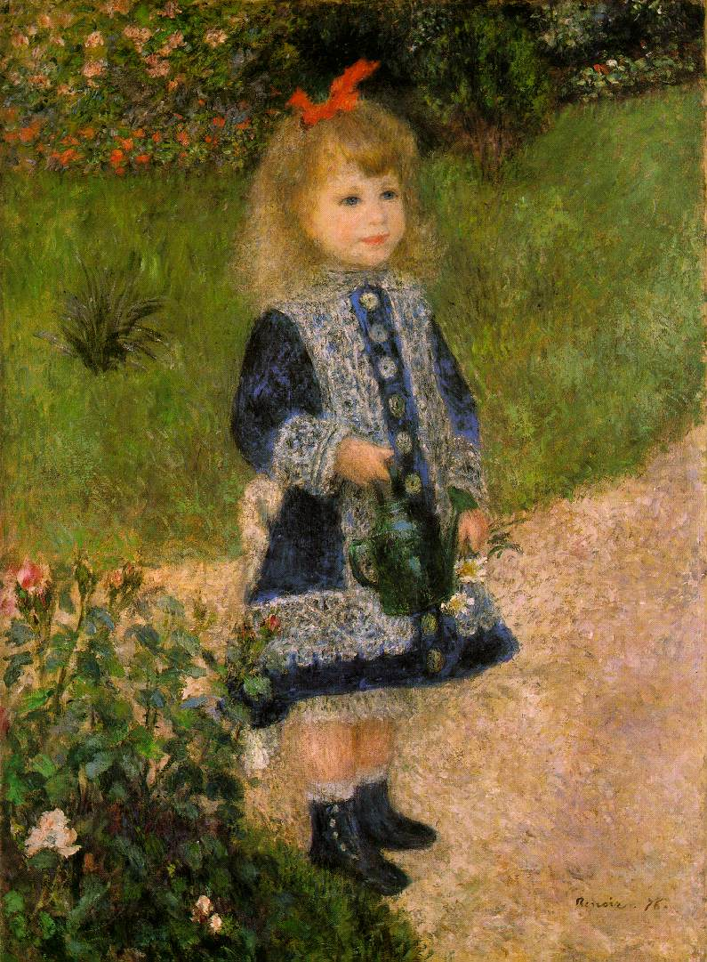
Renoir
Renoir. Girl with a Watering Can. 1876.
Notes:
Renoir as a landscapist and portrait painter; misanthropic views, women and children and attempt to separate “them from work and life’s harsh realities” (188), “what does the rest of humanity matter to them!” (190), “‘false mania of perfection’ has cast God out,” “nature was the place where man could free himself from the taint of civilization” (192) – brushwork as expression of culmination of a longing for the natural world and a rejection of urban-industrialism

Slide 29
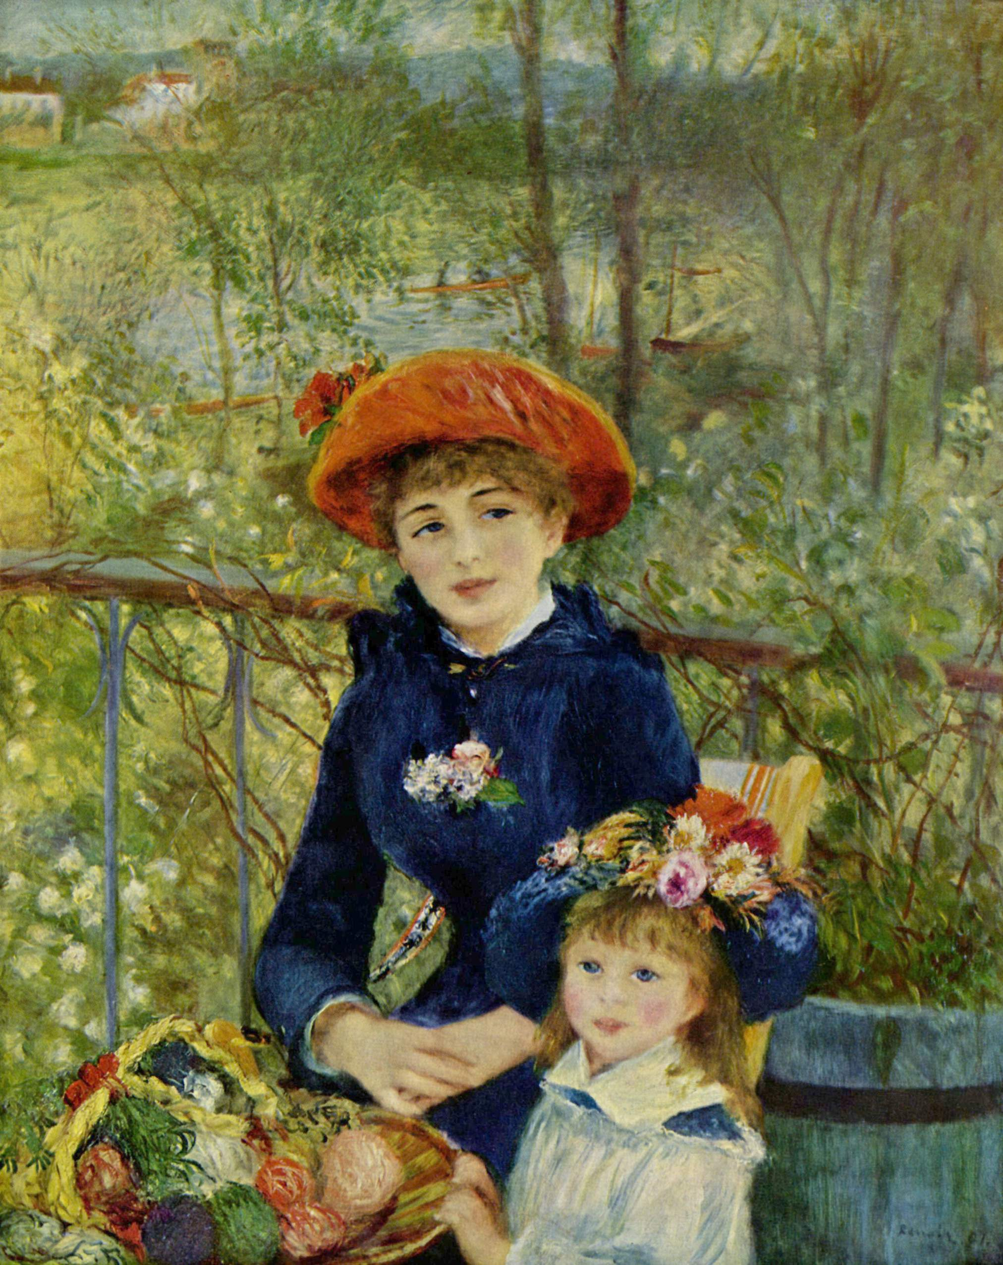
Renoir
Renoir. On the Terrace. 1881.
Notes:
Renoir as a landscapist and portrait painter; misanthropic views, women and children and attempt to separate “them from work and life’s harsh realities” (188), “what does the rest of humanity matter to them!” (190), “‘false mania of perfection’ has cast God out,” “nature was the place where man could free himself from the taint of civilization” (192) – brushwork as expression of culmination of a longing for the natural world and a rejection of urban-industrialism

Slide 30
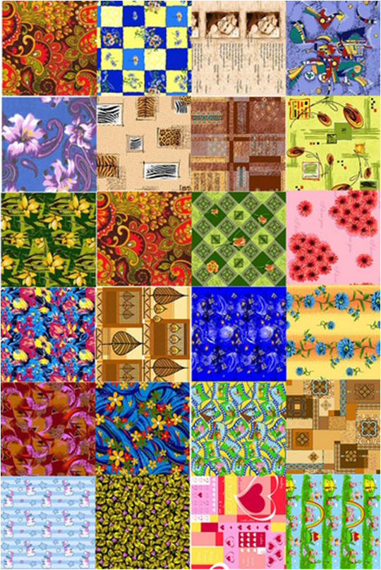
Influences of Painting
Notes:
Advances and revolutionary techniques: new color structure, perspective, geometry, flatness; “too daring in their brushwork;” artistic influences: textiles, décor, eighteenth century painting, and Japanese prints; attitudes of artists and the influence of these attitudes within their work – Renoir, Manet (150)

Slide 31
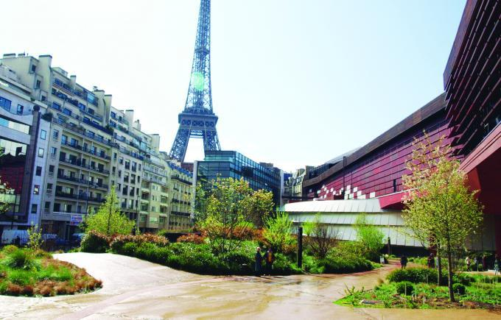
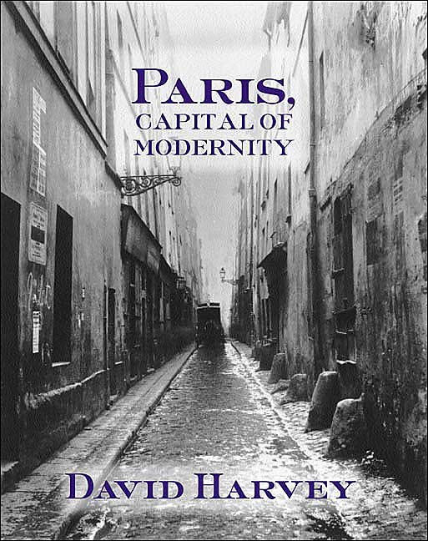
Modernity
Notes:
Modernity as a concept of “profound and rapid transformations” (169)

Slide 32
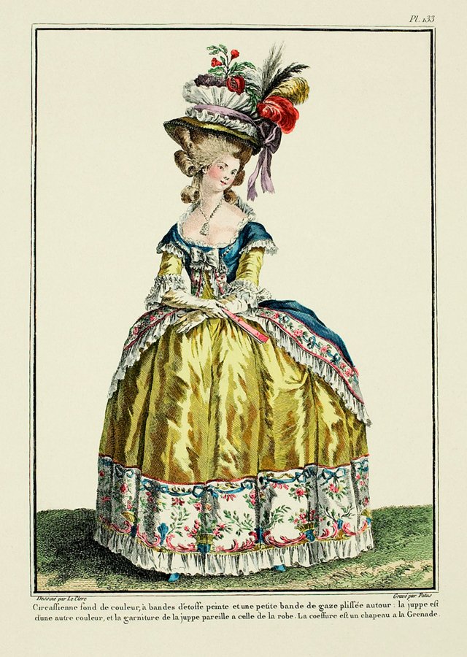
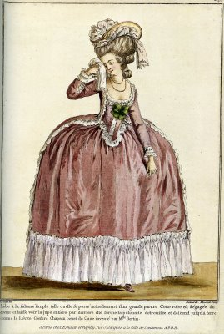
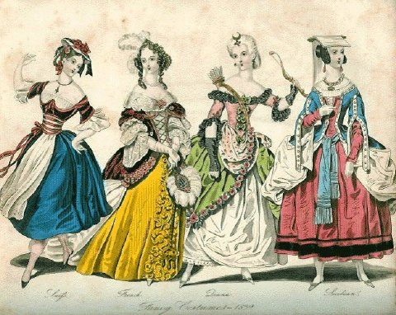
Fashion
Notes:
“As soon as a particular fashion caught on, its upper-class initiators deserted it….[because it was not distinct] from the common herd.” (178) – compare to today’s outrageous fashions typically deriving from France VIDEO

Slide 33
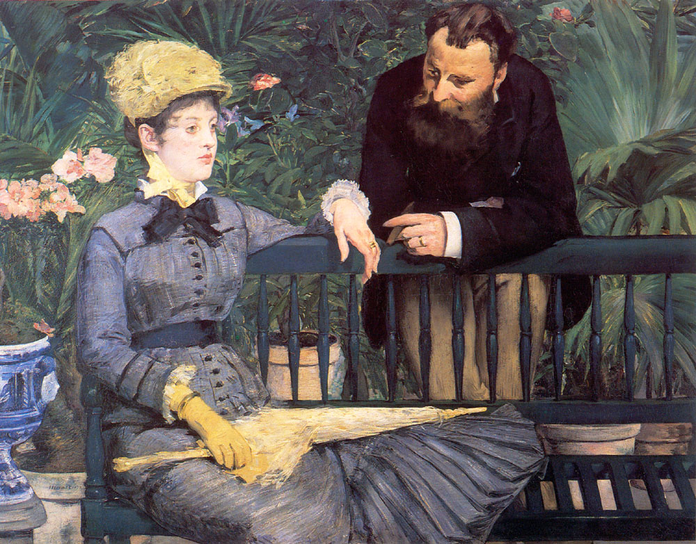
Fashion
Manet. In the Conservatory. 1885.
Notes:
“As soon as a particular fashion caught on, its upper-class initiators deserted it….[because it was not distinct] from the common herd.” (178) – compare to today’s outrageous fashions typically deriving from France

Slide 34
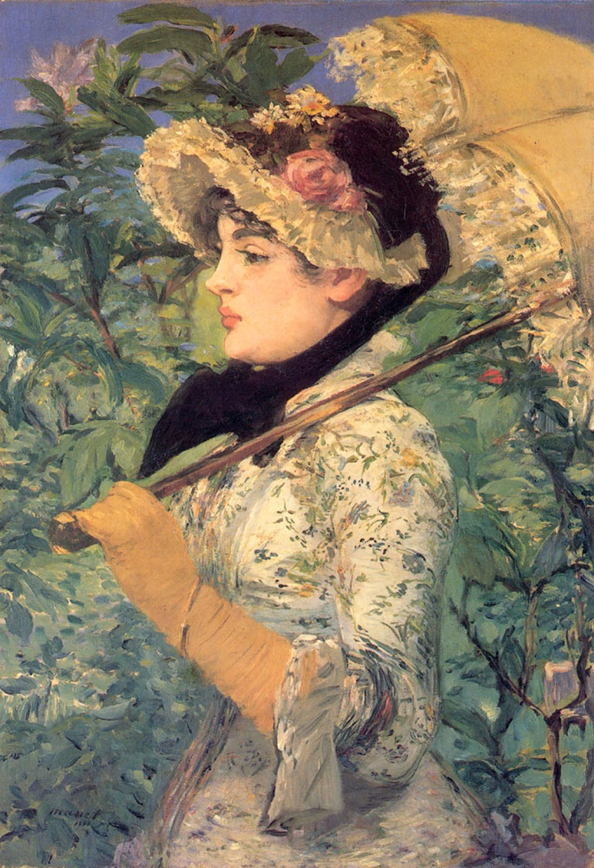
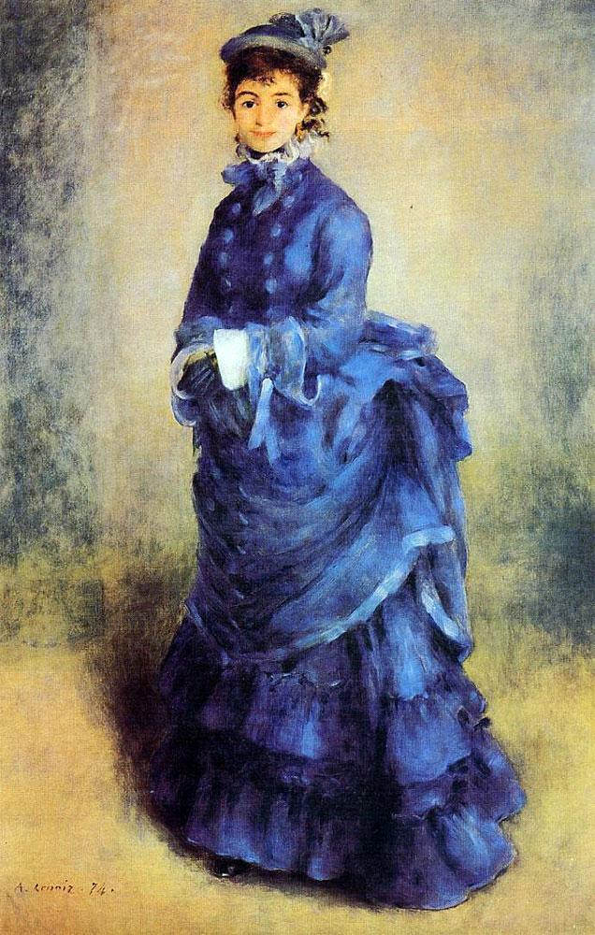
Fashion
Manet. Jeanne: Spring. 1881.
Renoir. La Parisienne. 1874.
Notes:
“As soon as a particular fashion caught on, its upper-class initiators deserted it….[because it was not distinct] from the common herd.” (178) – compare to today’s outrageous fashions typically deriving from France

Slide 35
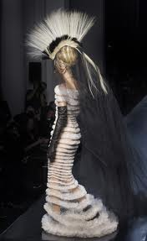
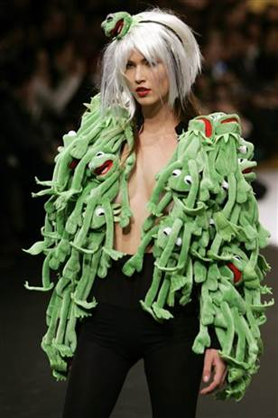
Fashion and Present Day
Notes:
“As soon as a particular fashion caught on, its upper-class initiators deserted it….[because it was not distinct] from the common herd.” (178) – compare to today’s outrageous fashions typically deriving from France

Slide 36
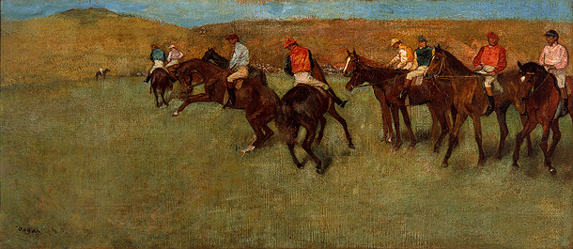
Discussion: Degas’s Jockeys as Neo-Gleaners?
Degas. At the Races. 1885.
Notes:
Thought/discussion: Could Degas’s secluded jockeys be a sort of neo-Gleaners with their absorption in their work and being defined as jockeys, often no faces (169)

Slide 37
Discussion: * Does Industry + Time + Money = Flâneur Detachment? * High Culture in Haussmanian Paris/Gardens? * In your opinion – Is Impressionism Overly Logical or Overly Emotional?
Notes:
Thought/discussion: mention suburban blues/depression after World War II

Slide 38
Pollock. Lavender Mist. 1950.

Slide 39
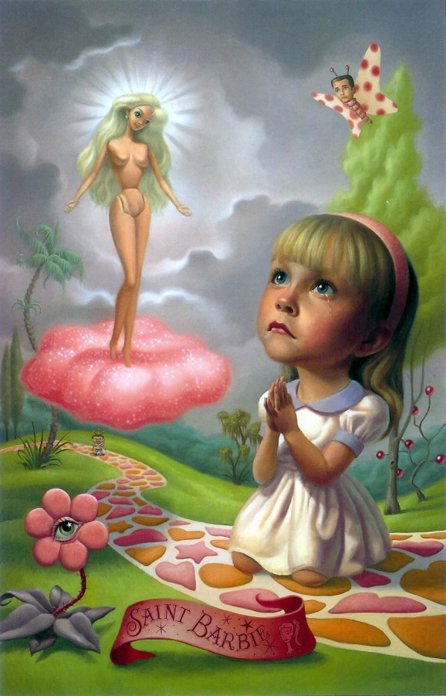
Ryden. Saint Barbie. 1994.

